Slide 1
STAT542
Comparison of Supervised Learning Algorithms on CIFAR-10 Dataset
Member: Zibo Gong, Jiayi Yu, Hanqi Tang, Hao Liang

Slide 2
Overview
Section 1: Problem & Goal
Section 2: Methodology
Section 3: Experimental Setup & Results
Section 4: Challenges, Solution & Lessons
Section 5: Conclusion & Q&A

Slide 3
Problem & Goal

Slide 4
Problem & Goal
Real‑world need: Phones, drones require lightweight but reliable vision models for on‑device moderation and navigation
Task: Using dataset CIFAR‑10 to classify 60,000 32 × 32 RGB images into one of 10 object categories
Goal: Benchmark six modelling families under a fixed Colab‑GPU budget and reach ≥ 0.65 accuracy

Slide 5
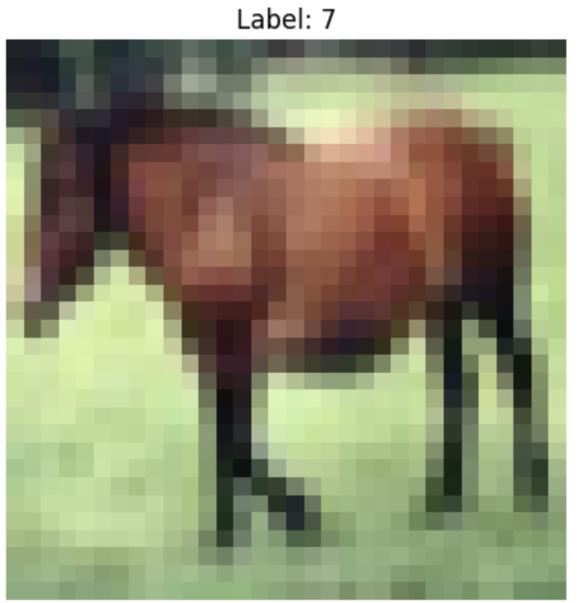
Dataset Overview
Dataset: CIFAR‑10 (Canadian Institute For Advanced Research)
Composition: 60,000 color images — 50,000 train, 10,000 test; equal distribution across 10 classes
Class list: airplane ✈️, automobile 🚗, bird 🐦, cat 🐱, deer 🦌, dog 🐶, frog 🐸, horse 🐴, ship 🚢, truck 🚚.
Resolution: 32 × 32 pixels → only 3072 features per image

Slide 6
Evaluation Criteria
Primary metric:
Overall Accuracy on the unseen test set (target ≥ 0.65)
Secondary metrics:
Log‑Loss (calibration)
Per‑class Precision/Recall/F1 (individual class)
Validation:
Stratified 5‑fold cross‑validation on the 50k training set for hyper‑parameter tuning
Compute budget:
Single Colab T4 GPU (8 GB); deep/Bayesian nets capped at ≤ 5 epochs

Slide 7
Methodology

Slide 8
Baseline Models at a Glance
Model | Key Setup | Accuracy | Log-loss
Logistic Regression (With PCA) | PCA=200,default(C = 1, lbfgs) , max_iter 500 | 0.41 | 1.71
Logistic Regression | no PCA, default(C = 1, lbfgs), max_iter 500 (conv. warning) | 0.39 | 1.79
Random Forest | 50 trees ,random_state=42 | 0.41 | 1.90
KNN | PCA=200, k = 5, metric=euclidean | 0.36 | 12.28
MLP (With PCA) | PCA=200, hidden 1000, max iter=20, random state=42 | 0.56 | 1.75
MLP | no PCA, hidden 1000 , max_iter 20, random_state=42 | 0.50 | 1.42
Hyper‑parameter grids & tuning curves → Slide 15

Slide 9
Algorithm 1: Convolutional Neural Network
Why a CNN? Convolution layers slide small learnable kernels across the image, detecting edges, textures and shapes regardless of position. Parameter sharing keeps the network compact compared with fully‑connected layers, making it ideal for tiny 32 × 32 inputs.
Our micro‑architecture [Conv 3×3, 32] → ReLU → Conv 3×3, 64 → ReLU → MaxPool 2×2 (repeat once) → FC 128 → Softmax 10 Only ≈ 120 k trainable weights – tiny by modern standards

Slide 10
Algorithm 1: Convolutional Neural Network
Training:
Optimizer Adam (lr = 1e‑3, β₁ = 0.9)
Batch size 64, 5 epochs to respect Colab quota
Cross‑Entropy loss
Performance: Accuracy 0.70, Log‑Loss 0.87 → +24 pp over best classical model.
Pros/Cons: Inference latency < 2 ms on GPU, suitable for real‑time edge use.

Slide 11
Algorithm 2: Bayesian CNN (BNN)
Motivation: A deterministic CNN outputs a point probability but cannot say how unsure it is. A Bayesian CNN treats each weight as a distribution, yielding predictive uncertainty – crucial when models run unsupervised in the wild.
How we approximate the posterior:
Replace Conv / Linear with BayesianConv2d / BayesianLinear (blitz‑bayesian‑pytorch).
Optimise the ELBO: data log‑likelihood − KL divergence to prior.
Monte‑Carlo sampling (3 weight draws) during each forward pass.

Slide 12
Algorithm 2: Bayesian CNN (BNN)
Training: Same backbone as Simple CNN; 5 epochs; Adam 1e‑3; prior ~ 𝒩(0, 1). ELBO weight λ = 1/N to balance fit vs complexity.
Performance： Accuracy 0.63, Log‑Loss 1.04 (better calibrated)，
−7 pp accuracy vs Simple CNN.
Pros / Cons: Highlights ambiguous images; 3 × slower inference due to sampling.

Slide 13
Experiments Setup & Results

Slide 14
Experimental Setup
Pre‑processing: Resize;
PCA sweep 10–200 → choose 200 components (≈ 95 % variance) for classical models.
Validation: Stratified 5‑fold CV on 50k training data.
Search grids: LR C ∈ {0.1, 1, 10}; RF n_trees 20‑200; KNN k 2‑10.
Hardware: Google Colab T4 GPU (8 GB), PyTorch 2.x, scikit‑learn 1.5.

Slide 15
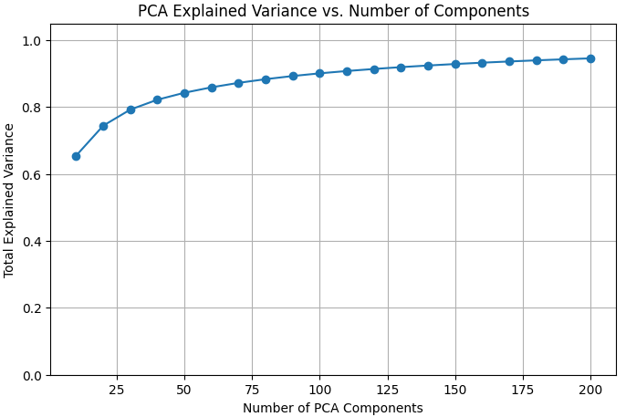
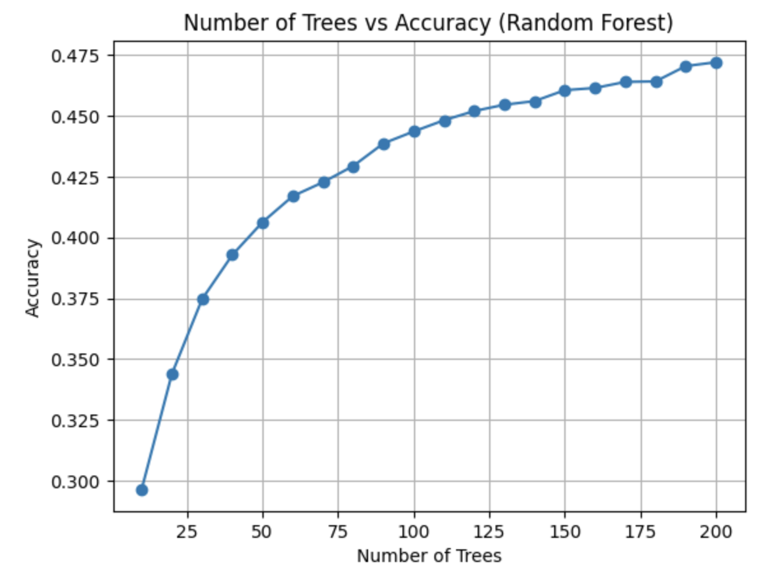
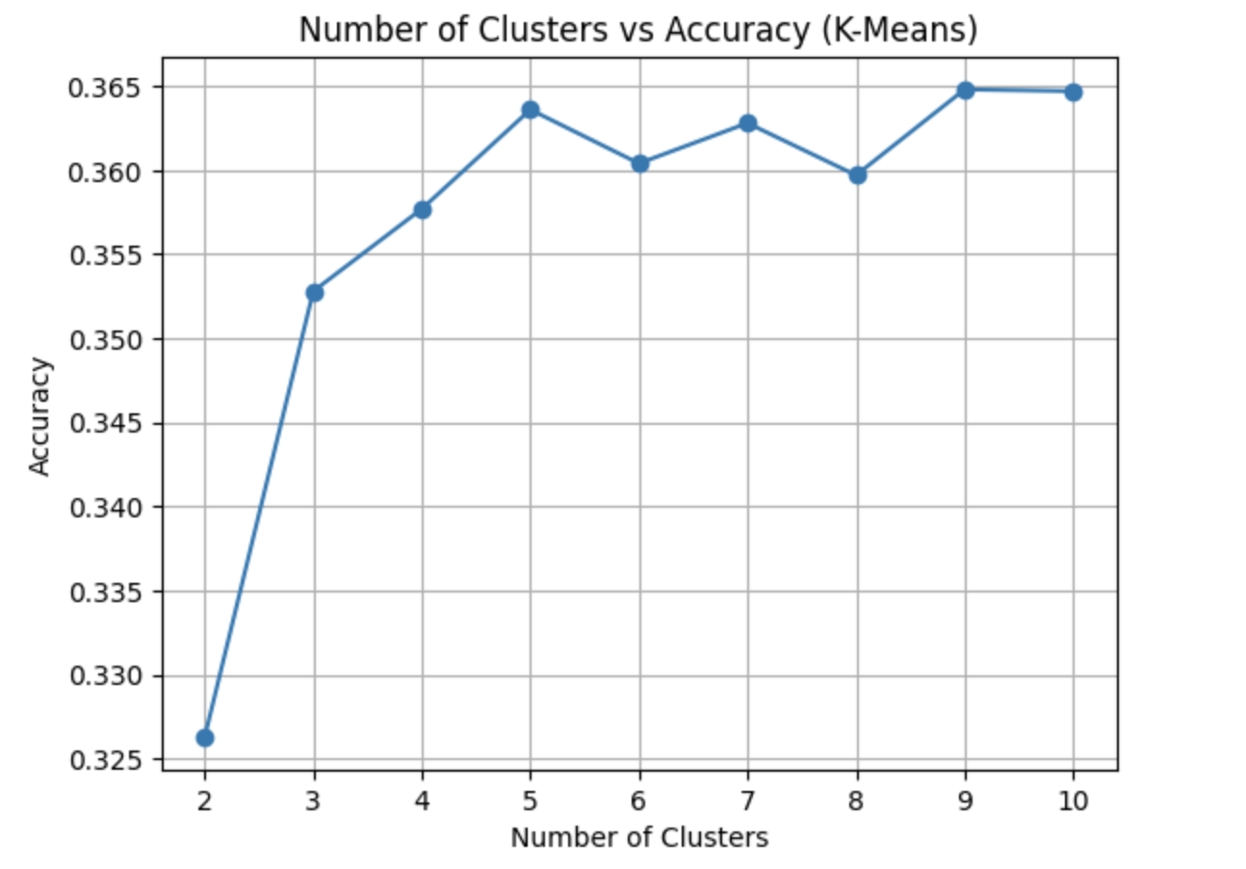
Hyperparameter Grids & Tuning
Three quick scans show how we chose key hyper‑parameters.
PCA: Explained Variance vs #Components — 200 comps ≈ 95 %.
Random Forest: Number of Trees vs Accuracy —we picked 50
KNN: Number of Neighbors vs Accuracy — peak at k = 5.

Slide 16
Performance Summary
Model | Accuracy | Log-loss | Training Speed | Inference Speed | Notes/Trade-off
Logistic Reg | 0.41 | 1.71 | Very Fast | Very Fast | Simplest but not fit for images
Random Forest | 0.41 | 1.90 | Slow | Medium | Training increases with # of trees; not good for images
KNN | 0.36 | 12.28 | No Training | Slow | Inference is very expensive
MLP | 0.56 | 1.75 | Medium | Fast | Can not capture pixel correlations
BNN | 0.63 | 1.04 | Very Slow | Medium | Training and Inference is very expensive
Simple CNN | 0.70 | 0.87 | Very Slow | Fast | Optimized for images

Slide 17
Performance Summary cont’d
Model | Accuracy | Log-loss
Simple CNN | 0.70 | 0.87
VGG-16 | 0.78 | 0.78
Resnet-18 | 0.76 | 0.75
Deeper network architecture (more parameters) can capture more information
Delicate design of networks can also be beneficial to performance

Slide 18
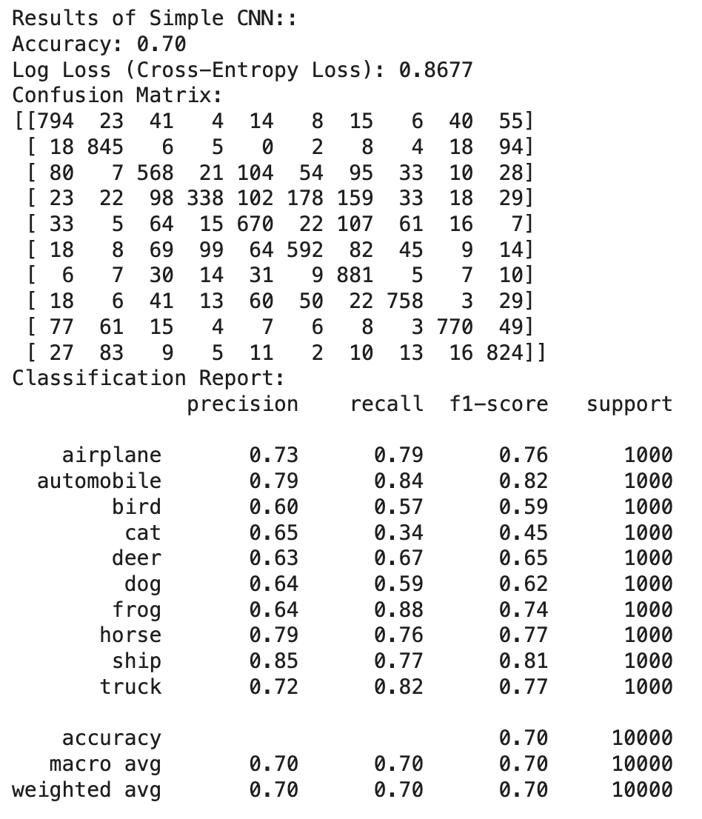
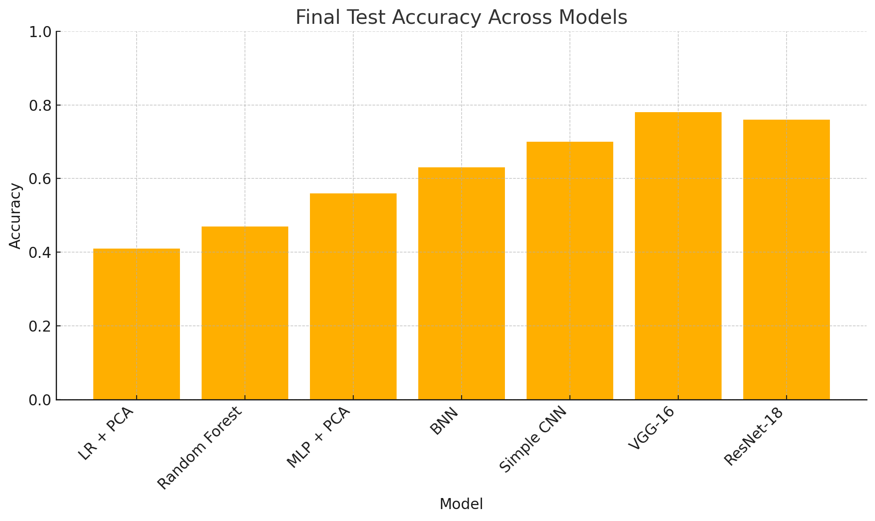
Results Visuals

Slide 19
Challenges, Solution & Lesson

Slide 20
Challenges & Fixes
High‐dimensional pixel inputs
Classical pipelines (LR, RF, KNN, MLP) struggled with 3×32×32=3,072 features → applied PCA (200 components) to reduce to 200 dims, speeding training & curbing over-fit.
Visual class confusion
“cat vs dog” or “deer vs horse” easily misclassified by flat models
→ Simple CNN’s spatial convolutions capture texture/shape; BNN adds uncertainty maps to flag ambiguous examples.

Slide 21
Challenges & Fixes
Compute & memory limits
Google Colab GPU quotas prohibited deep grid searches → used shallow Simple CNN with early stopping for quick prototyping, then leveraged VGG-16 and ResNet-18 only in final runs.

Slide 22
Lessons Learned
Dimensionality reduction vital for classical ML; CNN learns from raw pixels.
Classical ML + PCA: Effective for lower‐dimensional signals but plateaus (~56% accuracy).
Simple CNN: Shallow convnet learns end‐to‐end from raw pixels, achieves 70% accuracy with <2 ms inference.
BNN balances accuracy & calibrated uncertainty.
Deeper CNNs (VGG-16 & ResNet-18): Deeper architectures capture richer features, boosting accuracy to 78% with modest extra cost.

Slide 23
Conclusion

Slide 24
Key Takeaways
Simple CNN: Lightweight “from-scratch” model delivers the best speed-accuracy tradeoff (70% accuracy, 0.87 log-loss)
VGG-16 & ResNet-18: Deeper nets trained end-to-end achieve 78%/76% accuracy by leveraging hierarchical features.
BNN provides calibrated probabilities and uncertainty maps, though at a 7 pp accuracy cost.
Classical pipelines (LR, RF, KNN, MLP) : Despite hyper-parameter tuning and pca, plateau around 56%, highlighting need for spatial inductive bias.

Slide 25
Next Steps
Quantization
INT8-quaantize Simple CNN→0.5 ms on mobile/Jetson
Augmentation
Random crops, flips, color jetter →VGG-16/ResNet-18 >80%
Calibration
Temperature scaling on BNN → lower log-loss

Slide 26
Contribution
Zibo Gong：Experiments
Jiayi Yu：Challenges and Conclusion
Hanqi Tang： Methodology
Hao Liang：Problem & Goal

Slide 27
Thank you!

